Slide 1

Water Quality Management and Leakage Detection in Pipeline system

Slide 2

Introduction
This project aims to create a simple and efficient method of water leakage detection and quality management in pipeline systems.
The quality management system encompasses of checking the pH, turbidity, temperature.
Leakage detection is done using a water flow sensor.

Slide 3
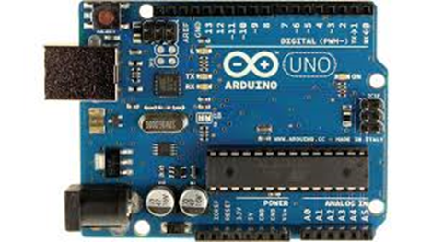
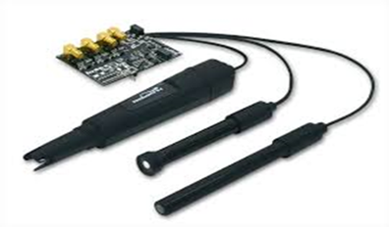
COMPONENTS
Arduino Uno
pH sensor (E-201 PH)
Turbidity sensor
Water flow sensor
16x2 LCD display
Buzzer

Slide 4
Working Principle
pH >7 or pH<7
WATER RESERVOIR
pH = 7
INDUSTRIAL USAGE
DRINKING WATER
IF FLOW SENSOR DETECTS LEAKAGE
ELSE
NOTIFIED USING LCD AND BUZZER
WATER IS SUPPLIED

Slide 5

Working
Initially the pH sensor and the turbidity sensor is placed in the water reservoir. If the pH of the water is not equal to 7 then the water is send for industrial purposes.
Else the water is supplied for domestic purposes through pipelines. These pipes are fitted with water flow sensor to detect leakages. If the flow is more than the threshold value, it would indicate a leakage using the LCD and buzzer .
These flow sensor can be placed for every 100m and hence the place of leakage can also be known using GPS.

Slide 6
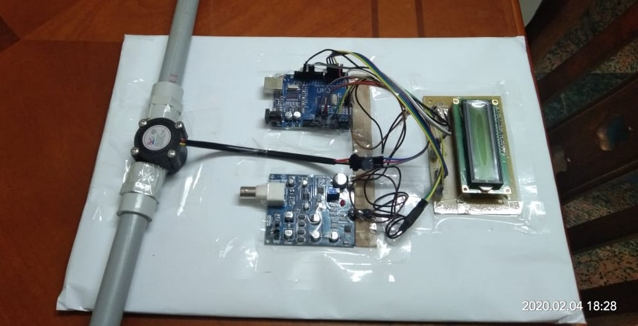
The interface used here is an Arduino microcontroller which collects the input signals from the sensors and accordingly relays them to the LCD or buzzer.

Slide 7


CONCLUSION
This project presents a simple and efficient solution to one of the major problems currently–water crisis.
Detection of leakages in underground pipeline systems is difficult, this makes the problem easier to rectify.

